Slide 1
The Ticking Beast
A deep dive into Timekeeper, Timers, Tick and
Tickless kernels.
(Linux Foundation webinar: Feb 22nd 2024)
Joel Fernandes (Google)
joel@joelfernandes.org
Public copy.

Slide 2
Who am I ?
Joel Fernandes (Google)
joel@joelfernandes.org

Slide 3
Agenda
Userspace time APIs
Clocksource
Time stamp counter (TSC)
Userspace timer APIs
Clockevents
Local APIC timer
HPET
Broadcast timers
Timer wheel
Hrtimer
Scheduling clock interrupt (tick) and NOHZ
VDSO (if time permits)
25 minutes
25 minutes
40 minutes

Slide 4
Userspace
How do you get the current time?
clock_gettime() API
int clock_gettime(clockid_t clockid, struct timespec *tp);
struct timespec {
time_t tv_sec; /* seconds */
long tv_nsec; /* nanoseconds */
};
Clock IDs for keep track of elapsed time.
CLOCK_REALTIME
CLOCK_MONOTONIC
CLOCK_BOOTIME
gettimeofday() directly operates on CLOCK_REALTIME.

Slide 5
Userspace
Let us go over Clock IDs
CLOCK_REALTIME
affected by changes in time by user
NTP (adjtime).
Used to correct time by adjusting clock rate till time is corrected.

Slide 6
Userspace
Let us go over Clock IDs
CLOCK_MONOTONIC
NOT affect by changes in time by user.
Affected by changes in time by adjtime (NTP changes clock rate).
Does NOT count suspend time.

Slide 7
Userspace
Let us go over Clock IDs
CLOCK_BOOTTIME
Identical to CLOCK_MONOTONIC except..
Accounts for suspend time.

Slide 8
Userspace
Clock ID behavior summary
Clock ID name | Time since | Can be set by user? | Can be set my adjtime | Accounts suspend time?
CLOCK_REALTIME | Epoch | Yes | Yes | Yes
CLOCK_MONOTONIC | Boot | No | Yes | No
CLOCK_MONOTONIC_RAW | Boot | No | No | No
CLOCK_BOOTTIME | Boot | No | Yes | Yes

Slide 9
Userspace
How do you set the time?
clock_settime() - set the time of the specified clock clockid.
int clock_settime(clockid_t clockid, const struct timespec *tp);
adjtime() - gradually correct the time
int adjtime(const struct timeval *delta, struct timeval *olddelta);
Clock is sped up over slow down a bit every second.
Typically used by NTP to adjust for clock drift.
settimeofday() counterpart to gettimeofday().

Slide 10
Userspace
How to get resolution of a clock?
int clock_getres(clockid_t clockid, struct timespec *res);
struct timespec {
time_t tv_sec; /* seconds */
long tv_nsec; /* nanoseconds */
};

Slide 11
Now lets look at how timekeeping is supported in the kernel..
Buckle up :)

Slide 12
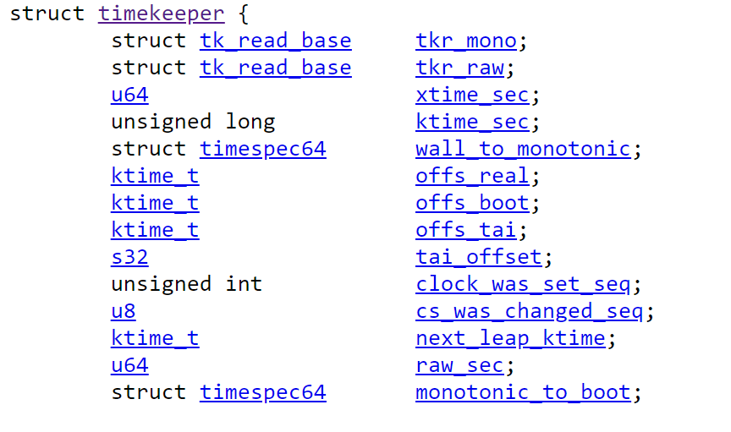
Kernel support - timekeeping
How does the kernel track different clocks?
Time is accumulated here
CLOCK_MONOTONIC and CLOCK_MONOTONIC_RAW
Offset to CLOCK_REALTIME
Offset to CLOCK_BOOTTIME
Offset to CLOCK_TAI

Slide 13
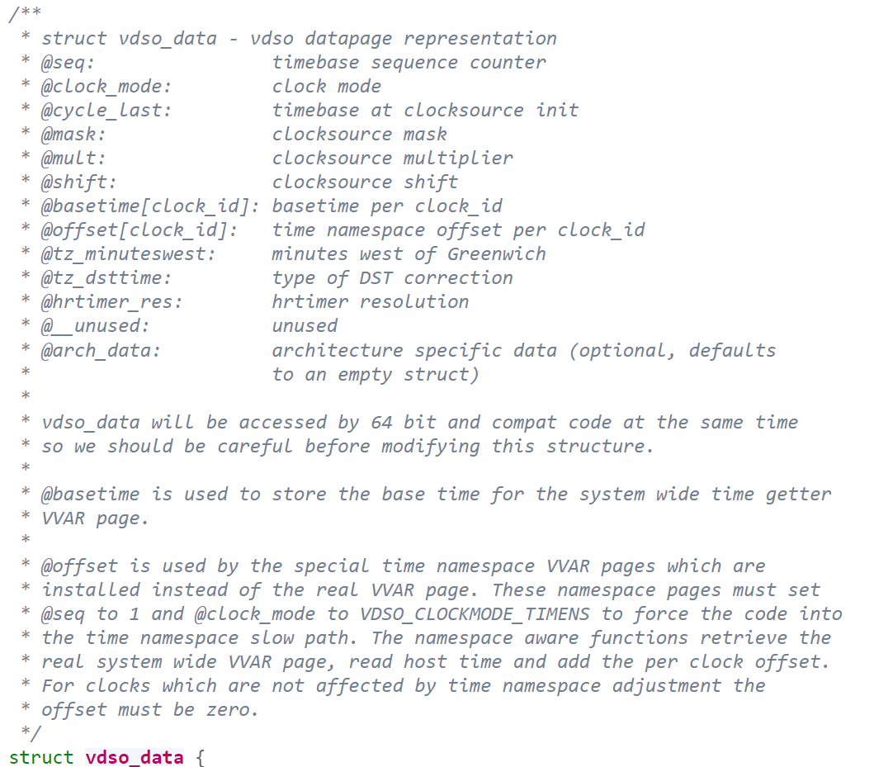
Kernel support - timekeeping
Several timekeeping APIs are in VDSO.
For instance, to get time userspace reads TSC and scales cycle delta from last read.

Slide 14
Kernel Support - timekeeping - Clocksource
A clocksource is an abstraction on simple clock (counter) that can be read from!
Struct clocksource
CPU
Read
Hardware
Counter

Slide 15
Kernel Support - timekeeping - Clocksource
Example: x86 Time stamp counter (TSC)
64-bit per-CPU counter, it is an MSR so fast!!! (slower than cache hit!)
High resolution (GHz), uses the CPU clock.
Read using the RDTSC instruction
RDTSCP also gives the CPU number on which the TSC was read.

Slide 16
Kernel Support - Clocksource: Abstraction of the hardware
Clocksource kernel API
struct clocksource {
cycle_t (*read)(struct clocksource *cs);
cycle_t mask;
u32 mult;
u32 shift;
// ...
};
clocksource_register_hz(struct clocksource *cs, u32 hz);
clocksource_register_khz(struct clocksource *cs, u32 khz);
Time difference
// Note that this breaks if clocksource on all CPUs are not synced!
struct clocksource *cs = &system_clocksource;
cycle_t start = cs->read(cs);
// ... /* do something for a while */
cycle_t end = cs->read(cs);
clocksource_cyc2ns(end - start, cs->mult, cs->shift);
Slide Courtesy: Stephen Boyd

Slide 17
So what do we use the clocksource for?
Timekeeping: Moving time in the system forward.
Reading time at a given instant.

Slide 18
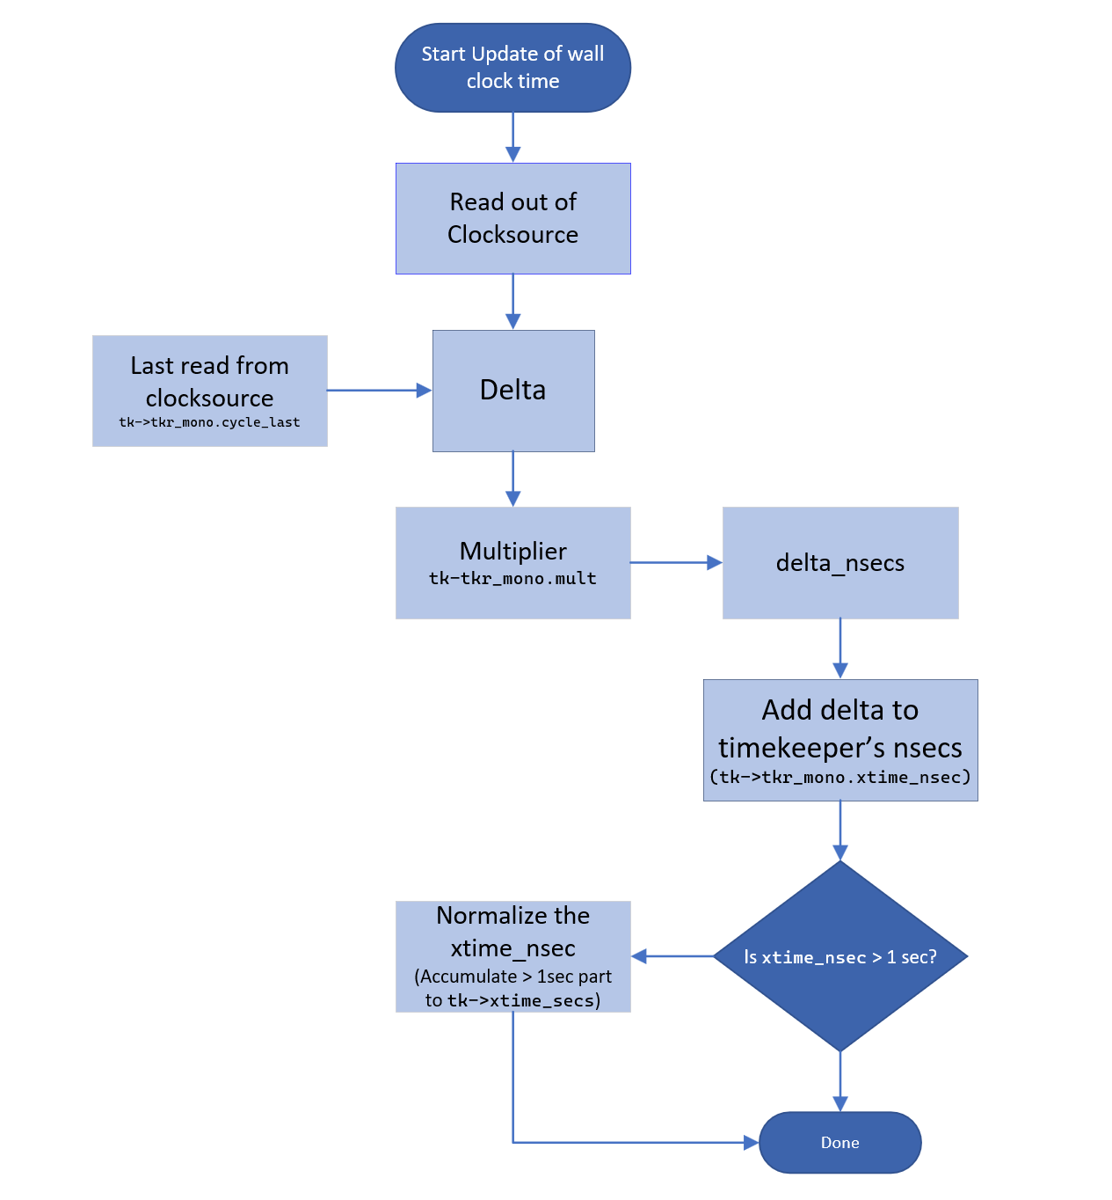
Kernel Support - Timekeeper update
Clocksource read during update_wall_time()
New clock = ((last_cycle - current cycle) * multiplier) + Old.
Update is done every jiffy.
Slide Courtesy: Stephen Boyd

Slide 19
Kernel Support - Timekeeper update
To summarize previous chart.
Clocksource is read and accumulated into struct timekeeper:
This structure has 2 components to keep track of time in seconds.
xtime_nsec : The time so far in nanoseconds.
xtime_sec : If the nsecs grows more than a second, it overflows into this element.
Number of cycles during last clocksource read is noted during every TK update.
Needed to update timekeeping.
As we’ll see next, needed to read instantaneous time as well.
Slide Courtesy: Stephen Boyd

Slide 20
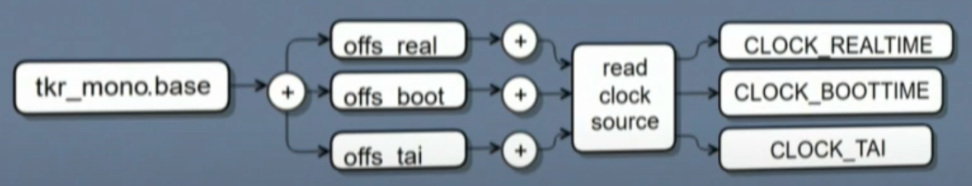
Kernel Support - Timekeeper readout
Q: That’s every jiffy but.. How is time at any instant read?
Ans: Timekeeper (last slide) + Clocksource Read (delta) + Adjustments
struct timekeeper {
struct tk_read_base tkr_mono;
u64 xtime_sec;
ktime_t offs_real;
ktime_t offs_boot;
ktime_t offs_tai;
...
}
Updated by update_wall_time()
Updated by NTP or clock_settime() for CLOCK_REALTIME
Updated with suspend time for CLOCK_BOOTTIME
Slide Courtesy: Stephen Boyd

Slide 21
Kernel Support - Timekeeping Accumulation (Code)
Few more things for completeness:
Wallclock time is updated every jiffy by a designated CPU:
tick_nohz_highres_handler() ->
tick_sched_do_timer() ->
tick_do_update_jiffies64() ->
update_wall_time()

Slide 22
Now let us jump into a real example of an x86 clock source
-- our old friend TSC again.
And what issues plague the TSC?

Slide 23
x86 Time stamp counter (TSC)
64-bit per-CPU counter, it is an MSR so fast!!! (slower than cache hit!)
High resolution (GHz), uses the CPU clock.

Slide 24
Kernel Support - Clocksource - TSC issues
TSC stability (frequency invariance).
CPU clock can change frequency and affect TSC increment rate.
Older CPU models unreliable to frequency dep, but recently constant.
Check "constant_tsc" flag in /proc/cpuinfo
If CPU does not have constant_tsc feature, then if cpufreq changes, TSC marked unstable (mark_tsc_unstable()).
Clocksource reselection happens once TSC clocksource is marked unstable. Switches to HPET via clocksource watchdog kthread.

Slide 25
Kernel Support - Clocksource - TSC issues
TSC stoppage (due to deep idle)
TSC can stop counting in idle states because depends on CPU clock liveness.
CPU PM may effect
Check “nonstop_tsc” flag in /proc/cpuinfo
If CPU does not have nonstop_tsc feature, then idle driver may mark TSC unstable (mark_tsc_unstable()) if deeper than C2 state is allowed / chosen.
Clocksource reselection happens once TSC clocksource is marked unstable. Switches to HPET.

Slide 26
Kernel Support - Clocksource - catch it red handed
Clocksource watchdog to keep an eye on clocksource stability
A timer is scheduled to run every half a second to verify clocksource stability for clocksources with CLOCK_SOURCE_MUST_VERIFY flag.
Another clocksource that does not have CLOCK_SOURCE_MUST_VERIFY is compared against. If large difference between the 2 clocksource’s understanding of time progression, clocksource is marked unstable.
Once marked unstable, kthread worker selects a new clocksource (like HPET for x86).

Slide 27
That’s it for clock source, timestamps..
Now lets see how timer events are handled

Slide 28
Userspace - Timers (will just skim through userspace to spend more time on the kernel part)
Timer is a mechanism to generate a notification at a future point of time.
POSIX timers
timerfd
sleep
timeouts for syscalls
hrtimer user in kernel

Slide 29
Userspace - POSIX timers
int timer_create(clockid_t clockid, struct sigevent *sevp, timer_t *timerid);
Create a per-process interval timer. Returns unique timer ID
Clockid is any of the clocks we discussed.
Some additional special clocks exist such as:
CLOCK_PROCESS_CPUTIME_ID - measures CPU time consumed by all threads.
CLOCK_THREAD_CPUTIME_ID - same but just for calling thread.
struct sigevent : specifies how the caller should be notified when the timer expires.

Slide 30
Userspace - POSIX timers - arming
int timer_settime(timer_t timerid, int flags,
const struct itimerspec *new_value,
struct itimerspec *old_value);
int timer_gettime(timer_t timerid, struct itimerspec *curr_value);
returns the time until next expiration & the interval
struct itimerspec {
struct timespec it_interval; /* Timer interval, (If 0, then timer is ONESHOT) */
struct timespec it_value; /* Initial expiration (relative to current time, can be changed by flags)
(If 0, disarms the timer) */
};
struct timespec {
time_t tv_sec; /* Seconds */
long tv_nsec; /* Nanoseconds */
};

Slide 31
Userspace - POSIX timers - arming
int timer_settime(timer_t timerid, int flags,
const struct itimerspec *new_value,
struct itimerspec *old_value);
int timer_gettime(timer_t timerid, struct itimerspec *curr_value);
struct itimerspec {
struct timespec it_interval;
struct timespec it_value;
};
Provide new interval

Slide 32
Userspace - POSIX timers - arming
int timer_settime(timer_t timerid, int flags,
const struct itimerspec *new_value,
struct itimerspec *old_value);
int timer_gettime(timer_t timerid, struct itimerspec *curr_value);
struct itimerspec {
struct timespec it_interval;
struct timespec it_value;
};
Provide new interval
Initial expiration (relative to current time, can be changed by flags)

Slide 33
Userspace - POSIX timers - arming
int timer_settime(timer_t timerid, int flags,
const struct itimerspec *new_value,
struct itimerspec *old_value);
int timer_gettime(timer_t timerid, struct itimerspec *curr_value);
struct itimerspec {
struct timespec it_interval;
struct timespec it_value;
};
Provide new interval
Frequency of expiration, If zero, the timer is one shot.
Initial expiration (relative to current time, can be changed by flags)

Slide 34
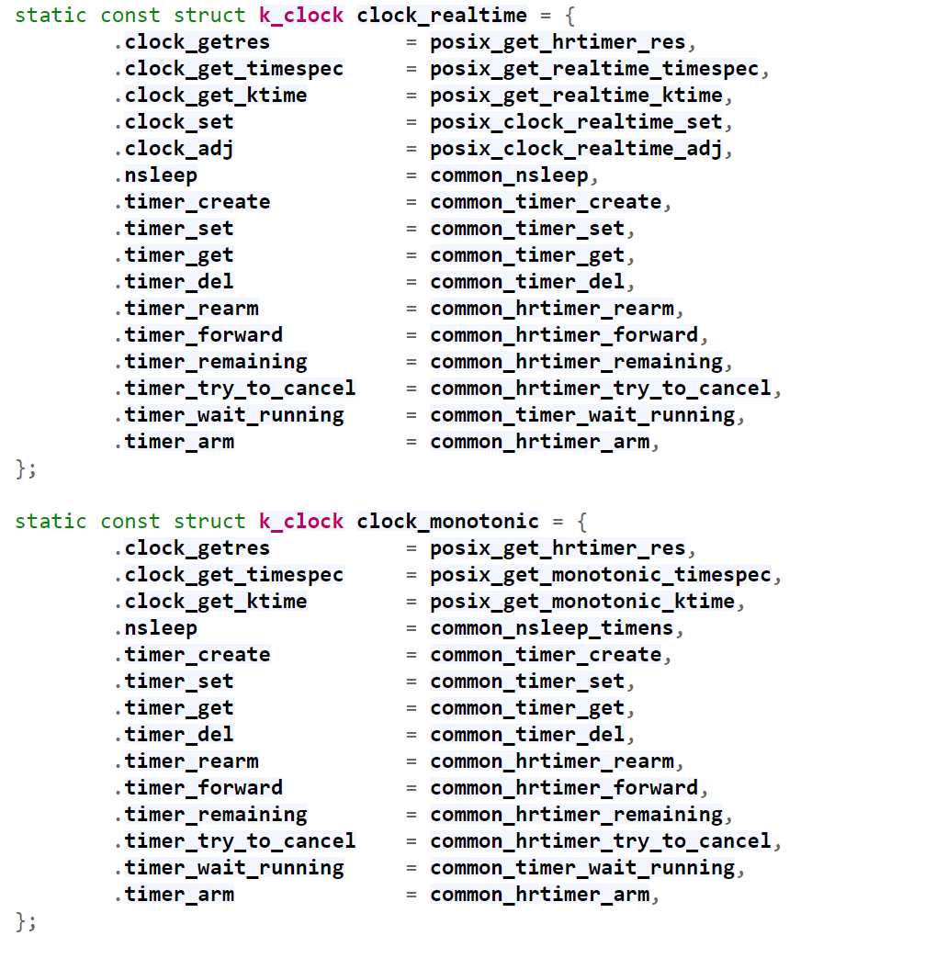
Userspace - POSIX timers
What does the kernel do internally?
For each clock, there is a struct kclock.
As you can see, it uses hrtimer under the hood.

Slide 35
A note on alarm clock ids and POSIX timers
There are 2 additional clock ids that can be used with userland timers:
CLOCK_REALTIME_ALARM
CLOCK_BOOTTIME_ALARM
When used, they wake the system up even during suspend. See kernel/time/alarmtimer.c
Uses RTC hardware which is active even when the system is suspended.

Slide 36
Userspace - timerfd
File descriptor based timers
Advantage is, can use select/poll because of fd.
This also allows uses hrtimer under the hood.
Will not go over more details, check documentation.

Slide 37
Userspace - Comparing POSIX timers and timerfd
Feature | timerfd | POSIX Timers
Identifier | File descriptor | Timer ID
Closing/Deletion | close() on the file descriptor | timer_delete()
Creation | timerfd_create() | timer_create()
Configuration/Arming | timerfd_settime() | timer_settime()
Portability | Linux-specific | POSIX standard, wider portability across Unix-like systems
Synchronization | Simplifies synchronization by using file descriptors | Requires careful signal handling, especially in multithreaded environments
Integration with Event Loops | Natural fit for event loops using epoll, select, or poll | Can we made to work with event loops but requires additional step like signalfd.

Slide 38
Kernel Support - Clockevents and timers
A clockevent device abstracts a device which generates interrupt at programmed time in the future.
There are 2 types of clockevents:
Per-CPU -- dependent of CPU , example LAPIC timer.
Global -- independent of CPU , example HPET.

Slide 39
Kernel Support - Clockevents
A clockevent device abstracts a device which generates interrupt at programmed time in the future.
struct clock_event_device {
void (*event_handler)(struct clock_event_device *);
int (*set_next_event)(unsigned long evt, struct clock_event_device *);
int (*set_next_ktime)(ktime_t expires, struct clock_event_device *);
ktime_t next_event;
u64 max_delta_ns;
u64 min_delta_ns;
u32 mult;
u32 shift;
unsigned int features;
#define CLOCK_EVT_FEAT_PERIODIC 0x000001
#define CLOCK_EVT_FEAT_ONESHOT 0x000002
#define CLOCK_EVT_FEAT_KTIME 0x000004
int irq;
// ...
};
void clockevents_config_and_register(struct clock_event_device *dev,
u32 freq, unsigned long min_delta,
unsigned long max_delta);

Slide 40
Kernel Support - Clockevents
A clockevent device abstracts a device which generates interrupt at programmed time in the future.
struct clock_event_device {
void (*event_handler)(struct clock_event_device *);
int (*set_next_event)(unsigned long evt, struct clock_event_device *);
int (*set_next_ktime)(ktime_t expires, struct clock_event_device *);
ktime_t next_event;
u64 max_delta_ns;
u64 min_delta_ns;
u32 mult;
u32 shift;
unsigned int features;
#define CLOCK_EVT_FEAT_PERIODIC 0x000001
#define CLOCK_EVT_FEAT_ONESHOT 0x000002
#define CLOCK_EVT_FEAT_KTIME 0x000004
int irq;
// ...
};
void clockevents_config_and_register(struct clock_event_device *dev,
u32 freq, unsigned long min_delta,
unsigned long max_delta);
Program next event
(relative and absolute).

Slide 41
Kernel Support - Clockevents
A clockevent device abstracts a device which generates interrupt at programmed time in the future.
struct clock_event_device {
void (*event_handler)(struct clock_event_device *);
int (*set_next_event)(unsigned long evt, struct clock_event_device *);
int (*set_next_ktime)(ktime_t expires, struct clock_event_device *);
ktime_t next_event;
u64 max_delta_ns;
u64 min_delta_ns;
u32 mult;
u32 shift;
unsigned int features;
#define CLOCK_EVT_FEAT_PERIODIC 0x000001
#define CLOCK_EVT_FEAT_ONESHOT 0x000002
#define CLOCK_EVT_FEAT_KTIME 0x000004
int irq;
// ...
};
void clockevents_config_and_register(struct clock_event_device *dev,
u32 freq, unsigned long min_delta,
unsigned long max_delta);
Run callback on next event.

Slide 42
Kernel Support - Clockevents
A clockevent device abstracts a device which generates interrupt at programmed time in the future.
struct clock_event_device {
void (*event_handler)(struct clock_event_device *);
int (*set_next_event)(unsigned long evt, struct clock_event_device *);
int (*set_next_ktime)(ktime_t expires, struct clock_event_device *);
ktime_t next_event;
u64 max_delta_ns;
u64 min_delta_ns;
u32 mult;
u32 shift;
unsigned int features;
#define CLOCK_EVT_FEAT_PERIODIC 0x000001
#define CLOCK_EVT_FEAT_ONESHOT 0x000002
#define CLOCK_EVT_FEAT_KTIME 0x000004
int irq;
// ...
};
void clockevents_config_and_register(struct clock_event_device *dev,
u32 freq, unsigned long min_delta,
unsigned long max_delta);
Run callback on next event.
Clock event features. ONESHOT is required for NOHZ

Slide 43
Kernel Support - Clockevents
Clockevent drives the timer events on every CPU
Timer wheel timers
struct clock_event_device {
void (*event_handler)(struct clock_event_device *);
int (*set_next_event)(unsigned long evt, struct clock_event_device *);
int (*set_next_ktime)(ktime_t expires, struct clock_event_device *);
ktime_t next_event;
u64 max_delta_ns;
u64 min_delta_ns;
u32 mult;
u32 shift;
unsigned int features;
#define CLOCK_EVT_FEAT_PERIODIC 0x000001
#define CLOCK_EVT_FEAT_ONESHOT 0x000002
#define CLOCK_EVT_FEAT_KTIME 0x000004
int irq;
// ...
};
void clockevents_config_and_register(struct clock_event_device *dev,
u32 freq, unsigned long min_delta,
unsigned long max_delta);
HRTimer timers
Timekeeping, Periodic Tick

Slide 44
Kernel Support - Clockevents
Clockevent Example: Local APIC timer (lapic)
Per-CPU Interrupt Controller with a timer.
Tightly coupled with CPU core.
Low precision (~MHz) as countdown rate determined by external bus freq.
Has a “TSC deadline mode” which gives it GHz precision.
Generates an IRQ whenever TSC crosses certain value.
Write absolute TSC deadline to IA32_TSC_DEADLINE MSR arms it.

Slide 45
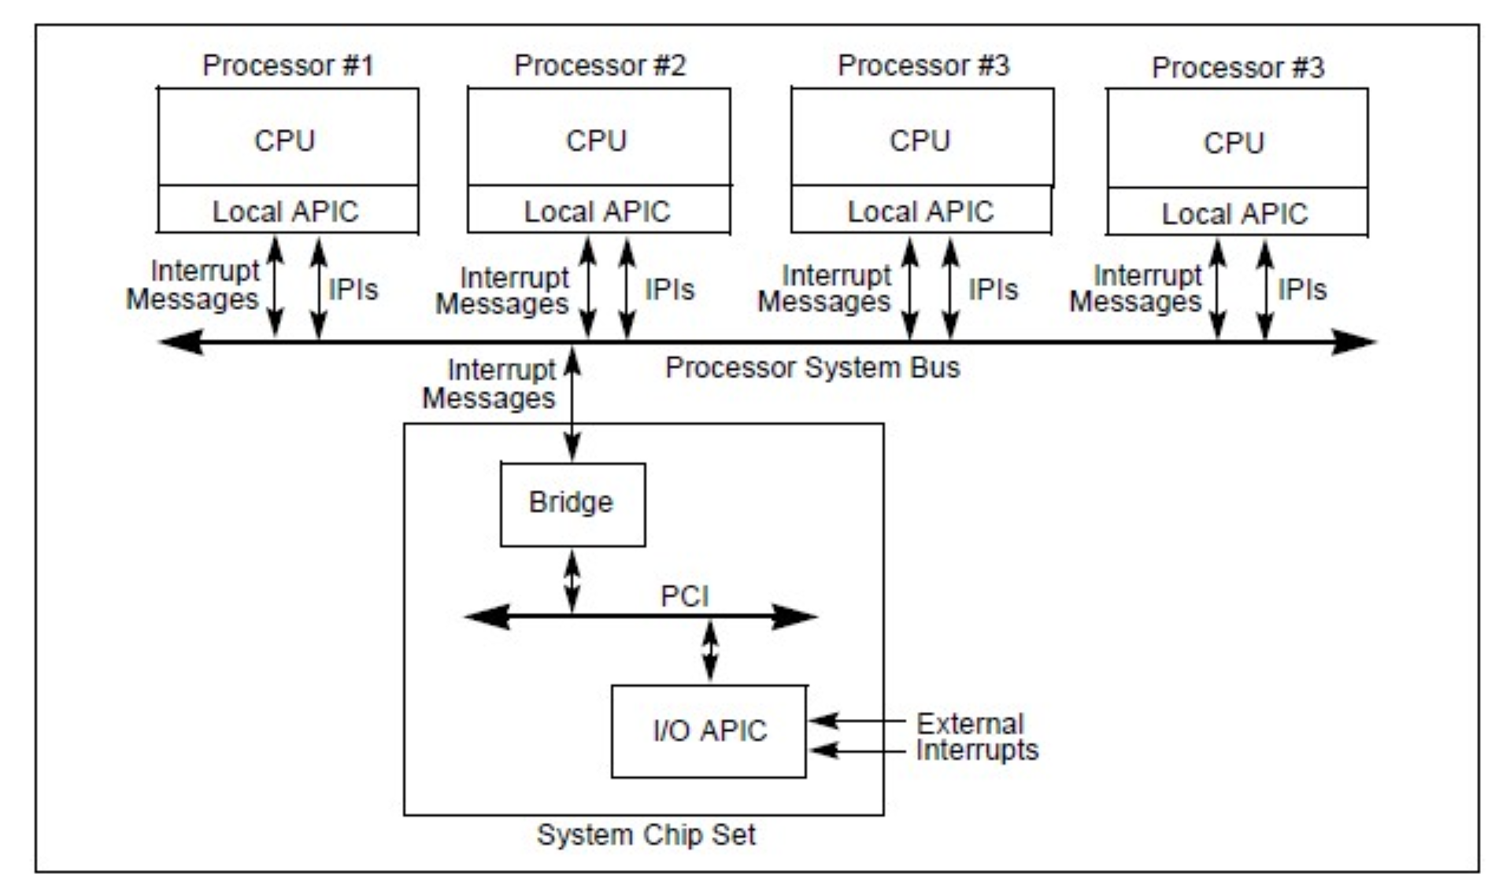
Kernel Support - Clockevent
Clockevent Example: Local APIC timer (lapic)

Slide 46
Kernel Support - Clockevent
Clockevent Example: HPET
Outside the CPU die
Lower resolution than Local APIC (MHz).
Applications / peripherals don’t need to depend on CPU for timing
Aggressive CPU power management states might turn off timers.
On systems without Deep C-states, Local APIC is preferred over HPET. See link.

Slide 47
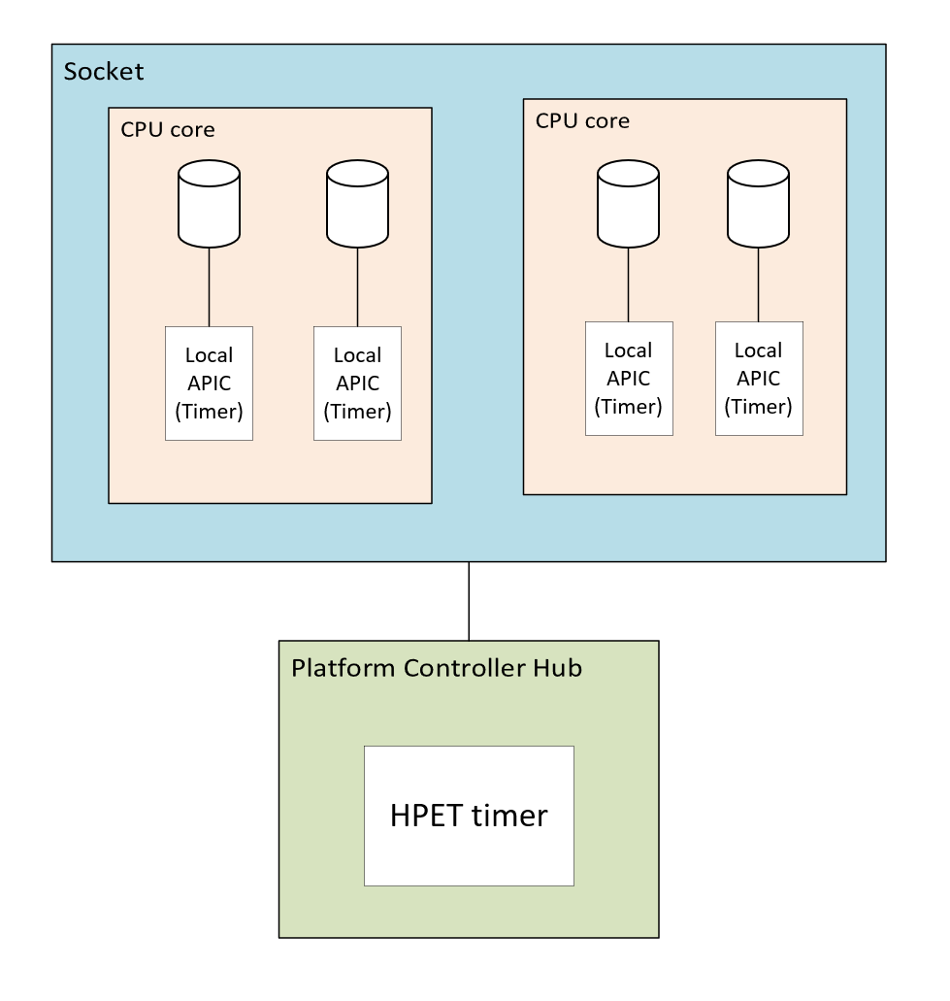
Kernel Support - Clockevent
Clockevent Example: HPET
Another diagram..
(PCH)

Slide 48
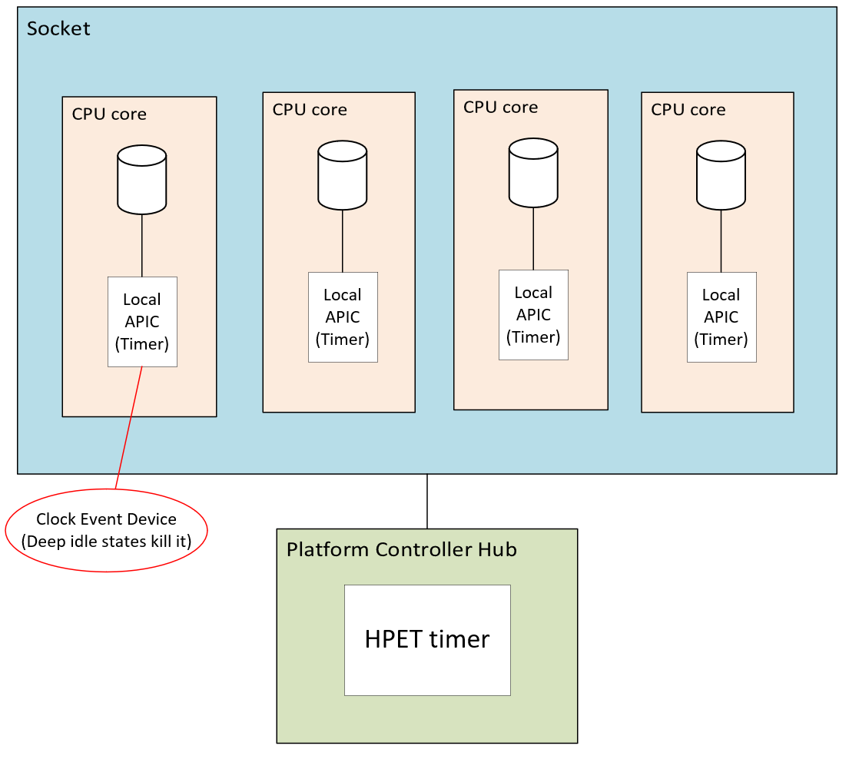
Kernel Support - Clockevent
Clockevent Example: HPET
Local APIC timer shuts down in
Deeper idle states (typically C3)

Slide 49
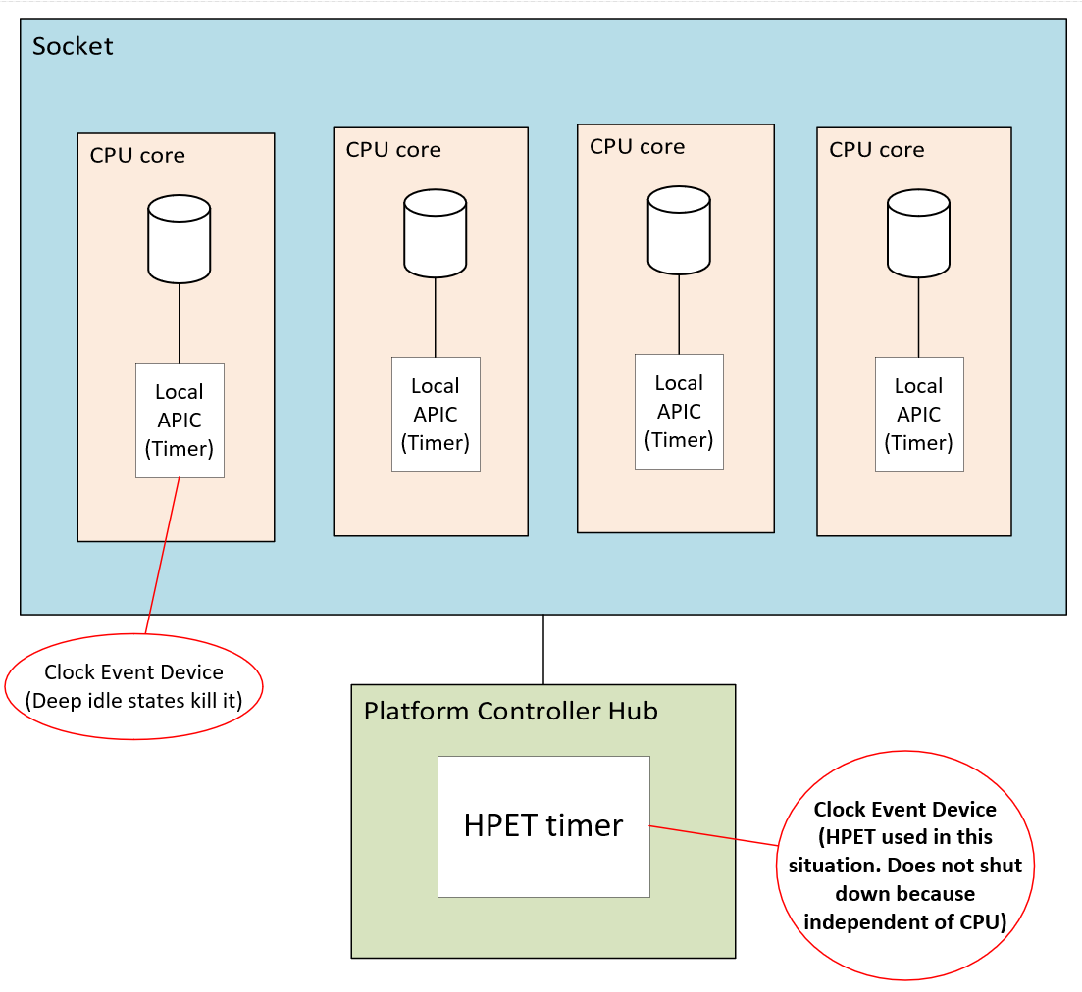
Kernel Support - Clockevent
Clockevent Example: HPET
HPET stays awake and can
be used (also known
as a broadcast timer)

Slide 50
Kernel Support - Clockevent
Clockevent Example: HPET
This is also known as “broadcast timer”.
To see the currently assigned broadcast timer,
# cat /sys/bus/clockevents/devices/broadcast/current_device # hpet

Slide 51
Kernel Support - Clockevent
Quiz: Obviously you have one HPET multiple CPUs that can be into deep idle state, how can that possibly work?
Just who are you kidding ???

Slide 52
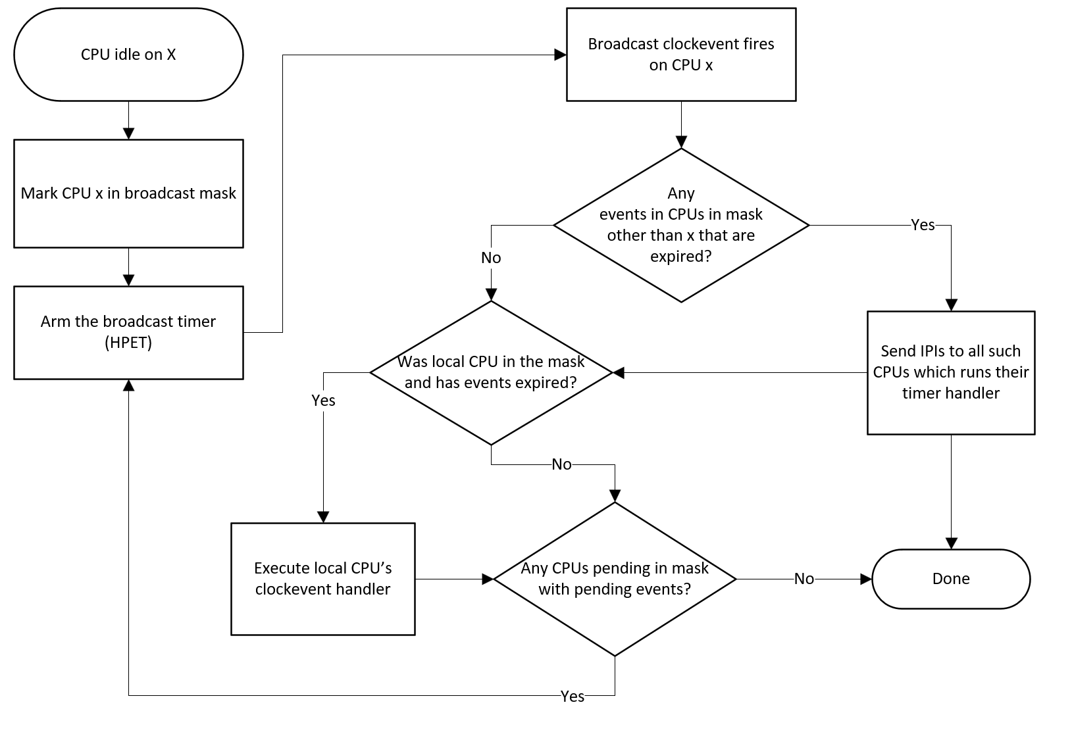
Kernel Support - Clockevent: Broadcast Algorithm
Main take away: A CPU mask keeps track of those CPUs in broadcast mode.
Broadcast timer repeatedly fires as many times as needed till mask empty.

Slide 53
Kernel Support - Clockevent
More about HPET
Can also be used as a clocksource instead of TSC.
Can be used as a stable reference for TSC (to know if TSC is unstable).
Slower than the TSC, not an MSR access but rather memory-mapped IO.

Slide 54
Kernel support - Timer wheel
Timer wheel - basic idea
Existed from Linux early days.
Timers that expire every 1/HZ (1 jiffy).
Need to sort timers by order of expiry (earlier expiring timers can be queued later)
Fast insertion, deletion expiry
Boils down to linked list tradeoff: Cannot have O(1) for insertion, removal and next expiry.
Can we gain O(1) and tradeoff space -- arrays!
Most timer wheel users are timeouts (canceled)

Slide 55
Kernel support - Timer wheel
How would you design and timer subsystem?
Need to sort timers by order of expiry (earlier expiring timers can be queued later)
Fast insertion, deletion expiry
Tradeoff: Cannot have O(1) for insertion, removal and next expiry with linked list!
Can we gain O(1) and tradeoff space? -- arrays!
Most timer wheel users are timeouts (canceled)

Slide 56
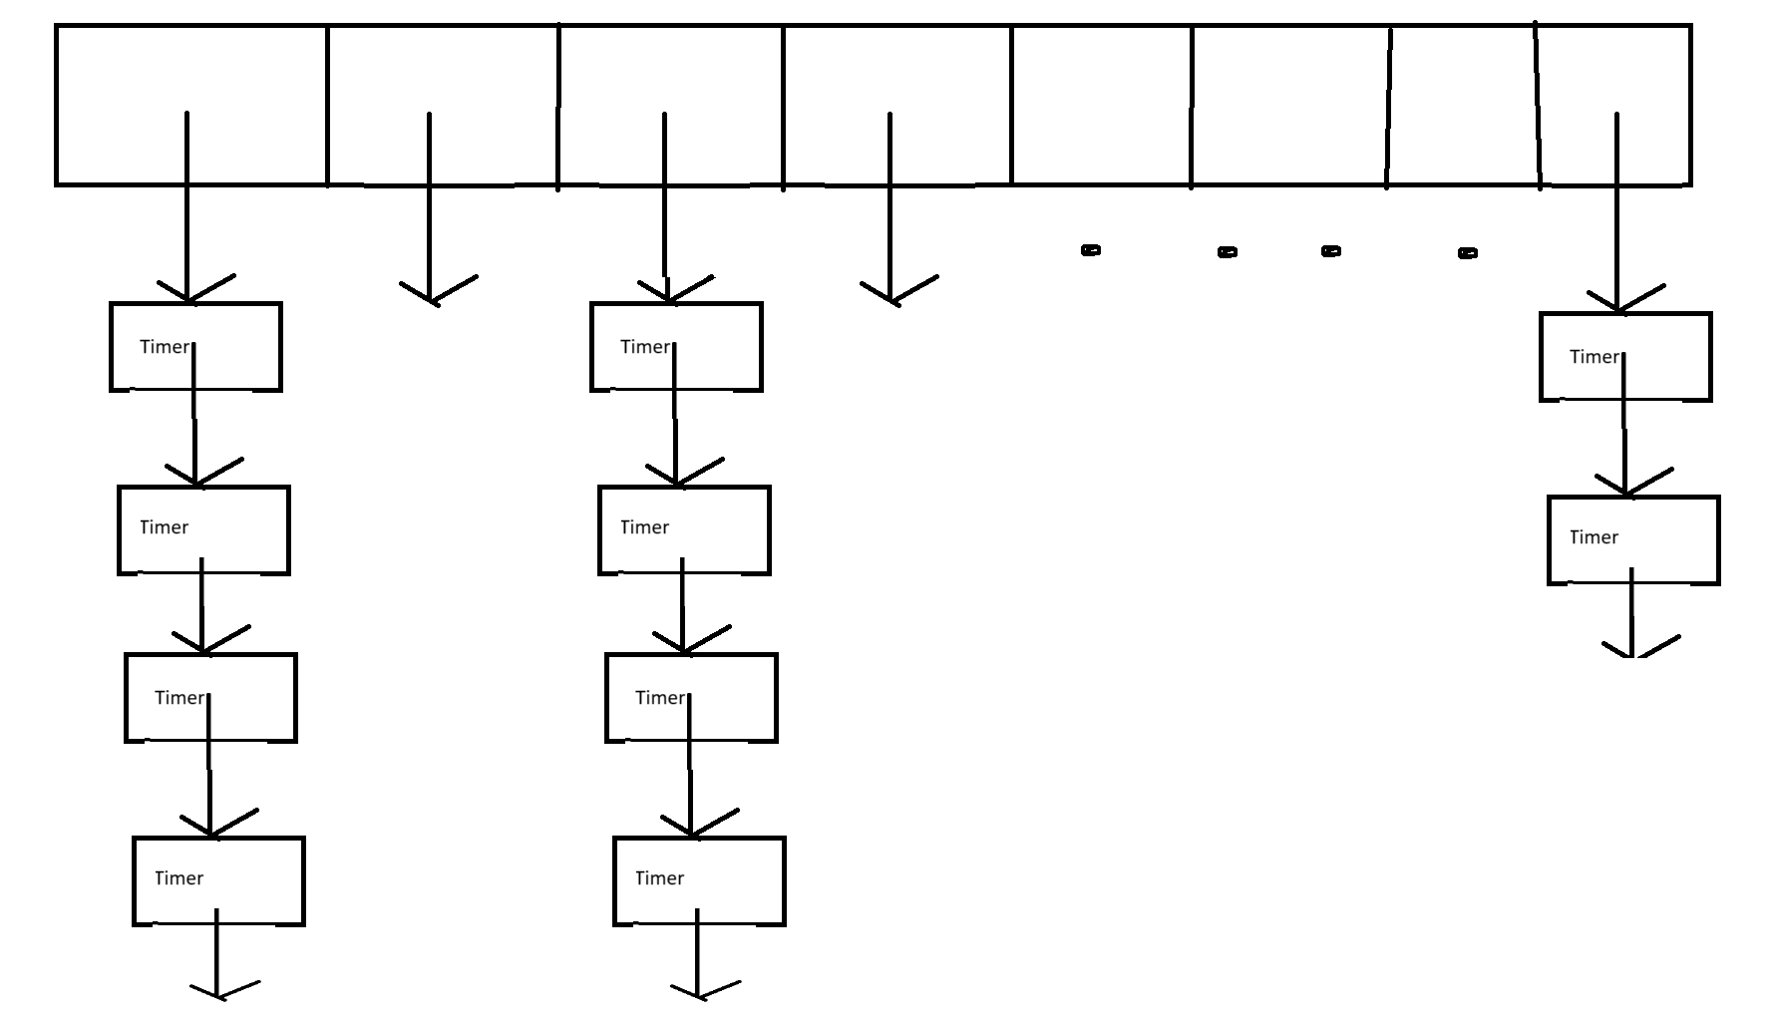
Kernel support - Timer internal implementation - timer wheel
Timer wheel FIRST level (HZ = 1000) - All timers from ~0ms to 63ms expiry are placed here
(Note the arrays are per-cpu. Timer expiry is per-cpu.)
1ms
1ms
1ms
1ms
1ms
1ms
1ms
1ms
Total 64 elements

Slide 57
Kernel support - Timer internal implementation - timer wheel
Timer wheel FIRST level (HZ = 1000) - What about > 63ms, can we keep having 1ms entries?
NO! Will need huge arrays!

Slide 58
Kernel support - Timer internal implementation - timer wheel
Timer wheel SECOND level (HZ = 1000) - All timers from 64ms to 511ms expiry are placed here
(64 to 127)
(128 to 191)
64ms
64ms
64ms
64ms
64ms
64ms
64ms
64ms
Total 64 elements

Slide 59
Keep moving the wheel till we hit end of first level..
Then take all timers out of first bucket of second level, move to first. Repeat.
(64 to 127)
The first level
1ms
Cascade
1ms
1ms
1ms
1ms
1ms
1ms
1ms

Slide 60
Keep moving the wheel till we hit end of first level..
Then take all timers out of first bucket of second level, move to first. Repeat.
(64 to 127)
The first level
1ms
Cascade
1ms
1ms
1ms
1ms
1ms
1ms
1ms

Slide 61
Cascading thought to not be worth it
Most timers and removed before expiry, so cascading efforts wasted.
All that while, also dirties cache lines moving timers between lists.

Slide 62
Kernel support - Timer internal implementation - timer wheel
No cascading of timers like before But now…
Larger the timeout, lower the granularity!
* HZ 1000 steps
* Level Offset Granularity Range
* 0 0 1 ms 0 ms - 63 ms
* 1 64 8 ms 64 ms - 511 ms
* 2 128 64 ms 512 ms - 4095 ms (512ms - ~4s)
* 3 192 512 ms 4096 ms - 32767 ms (~4s - ~32s)
* 4 256 4096 ms (~4s) 32768 ms - 262143 ms (~32s - ~4m)
* 5 320 32768 ms (~32s) 262144 ms - 2097151 ms (~4m - ~34m)
* 6 384 262144 ms (~4m) 2097152 ms - 16777215 ms (~34m - ~4h)
* 7 448 2097152 ms (~34m) 16777216 ms - 134217727 ms (~4h - ~1d)
* 8 512 16777216 ms (~4h) 134217728 ms - 1073741822 ms (~1d - ~12d)

Slide 63
Kernel support - Scheduling Clock Interrupt
A timer interrupt that goes at a fixed rate (HZ)
Interval of the interrupts is a “jiffie” (1 / HZ).
One of the primary functions of the tick is for preemptive multitasking.
The HZ rate is a balance between overhead and responsiveness.
“jiffies” is itself a global variable that is incremented by a designated CPU.

Slide 64
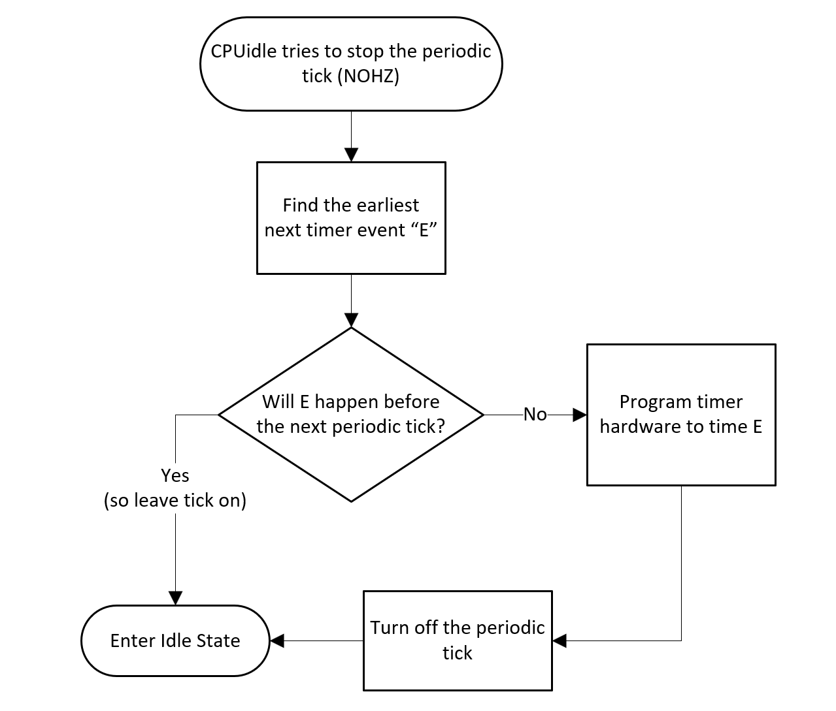
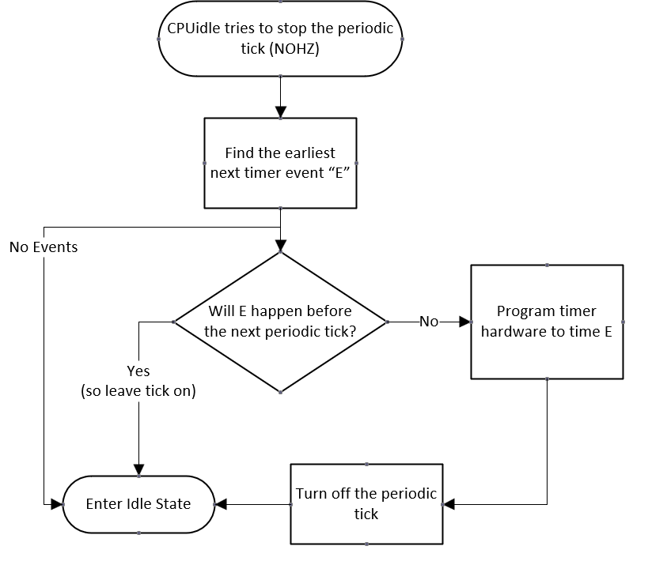
Kernel support - Deferrable timers (skip to 64 if no time)
A quick diagram on CPUidle trying to stop the periodic tick (NOHZ)
This is a clockevent programming

Slide 65
Kernel support - Deferrable timers
A quick diagram on CPUidle trying to stop the periodic tick
Deferrable timers are skipped when finding next event!

Slide 66
Kernel support - Deferrable timers
Deferrable timers have their own timer wheel:
Proof:
#ifdef CONFIG_NO_HZ_COMMON
# define NR_BASES 2
# define BASE_STD 0
# define BASE_DEF 1
#else
# define NR_BASES 1
# define BASE_STD 0
# define BASE_DEF 0
#endif
static DEFINE_PER_CPU(struct timer_base, timer_bases[NR_BASES]);

Slide 67
Kernel support - Deferrable timers
Deferrable timers initialization and firing
Deferred timers are initialized by a call to timer_setup() with the TIMER_DEFERRABLE flag.
The per-cpu clock event which is programmed for NON DEFERRABLE timer event fires:
tick_sched_handle() ->
update_process_times() ->
run_local_timers()

Slide 68
Kernel support - Deferrable timers
Deferrable timers initialization and firing
When this clock event fires, it also scoops up the expired deferrable timers:
/*
* Called by the local, per-CPU timer interrupt on SMP.
*/
static void run_local_timers(void)
{
struct timer_base *base = this_cpu_ptr(&timer_bases[BASE_STD]);
/* Raise the softirq only if required. */
if (time_before(jiffies, base->next_expiry)) {
if (!IS_ENABLED(CONFIG_NO_HZ_COMMON))
return;
/* CPU is awake, so check the deferrable base. */
base++;
if (time_before(jiffies, base->next_expiry))
return;
}
raise_softirq(TIMER_SOFTIRQ);
}

Slide 69
Kernel support - Deferrable timers
Deferrable timers initialization and firing
Finally, the timer softirq runs the deferred timers as well.
static void run_timer_softirq(struct softirq_action *h)
{
struct timer_base *base = this_cpu_ptr(&timer_bases[BASE_STD]);
__run_timers(base);
if (IS_ENABLED(CONFIG_NO_HZ_COMMON))
__run_timers(this_cpu_ptr(&timer_bases[BASE_DEF]));
}

Slide 70
Kernel support - Deferrable timers
Example of a Deferrable timer user:
static int init_worker_pool(struct worker_pool *pool)
{
[...]
timer_setup(&pool->idle_timer, idle_worker_timeout, TIMER_DEFERRABLE);
[...]
}
/**
* idle_worker_timeout - check if some idle workers can now be deleted.
* @t: The pool's idle_timer that just expired
*/
static void idle_worker_timeout(struct timer_list *t)

Slide 71
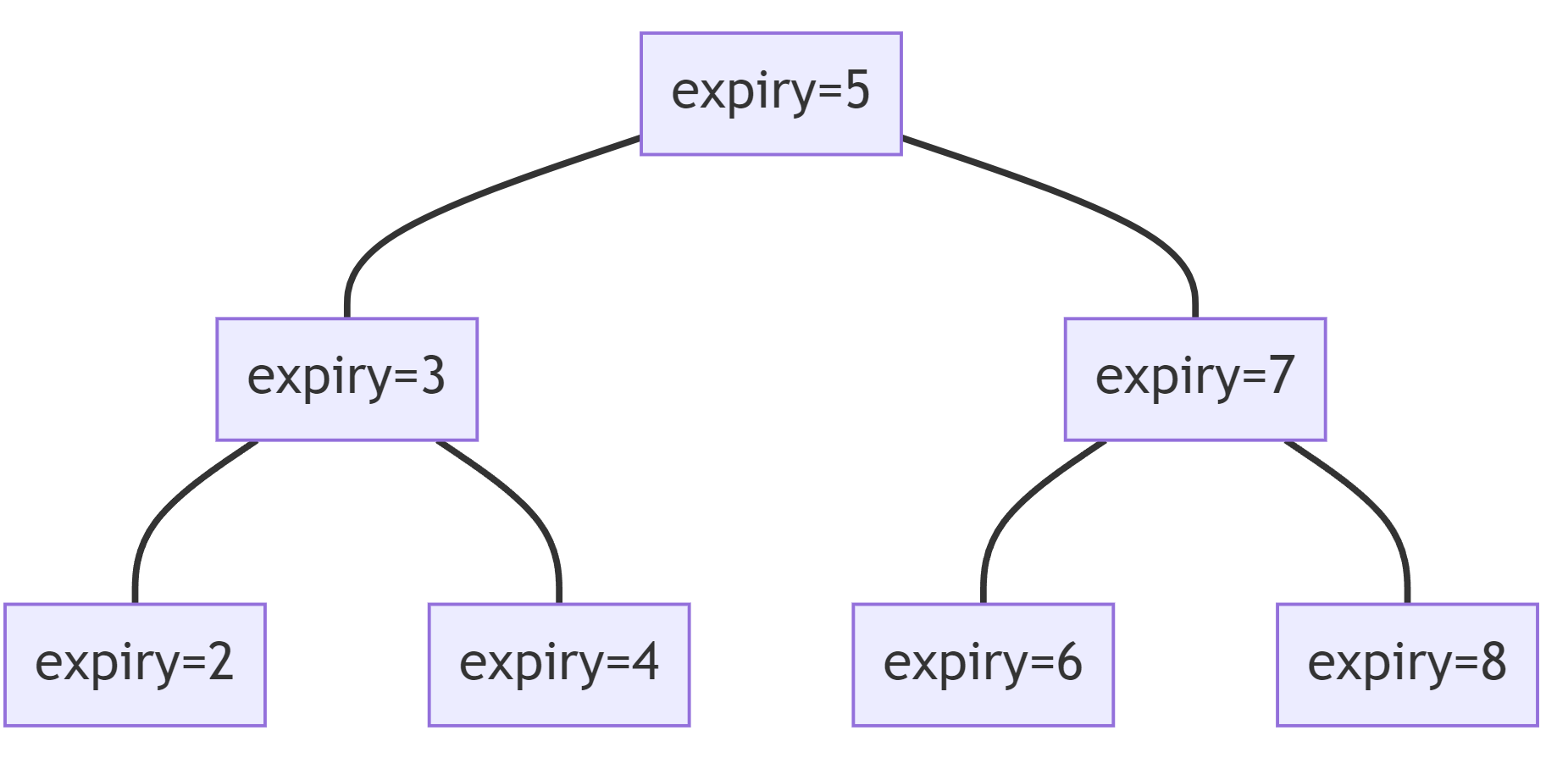
Kernel support - high resolution timers (hrtimer)
CPU 0
CPU 1
timerqueue_node
Hrtimer_clock_base
(CLOCK_MONOTONIC)
Hrtimer_clock_base
(CLOCK_MONOTONIC)
timerqueue_node
Hrtimer_clock_base
(CLOCK_REALTIME)
Hrtimer_clock_base
(CLOCK_REALTIME)
Hrtimer_clock_base
(CLOCK_BOOTTIME)
Hrtimer_clock_base
(CLOCK_BOOTTIME)

Slide 72
Kernel support - high resolution timers (hrtimer)
Hrtimer Range timers : Hrtimers can be queued with some “timer slack”
Normal hrtimers will have both a soft expiry and hard expiry which are equal to each other.
But hrtimers with slack will have a soft expiry & hard expiry which is the soft expiry + delta.
The idea is to reduce wakeups and save power.

Slide 73
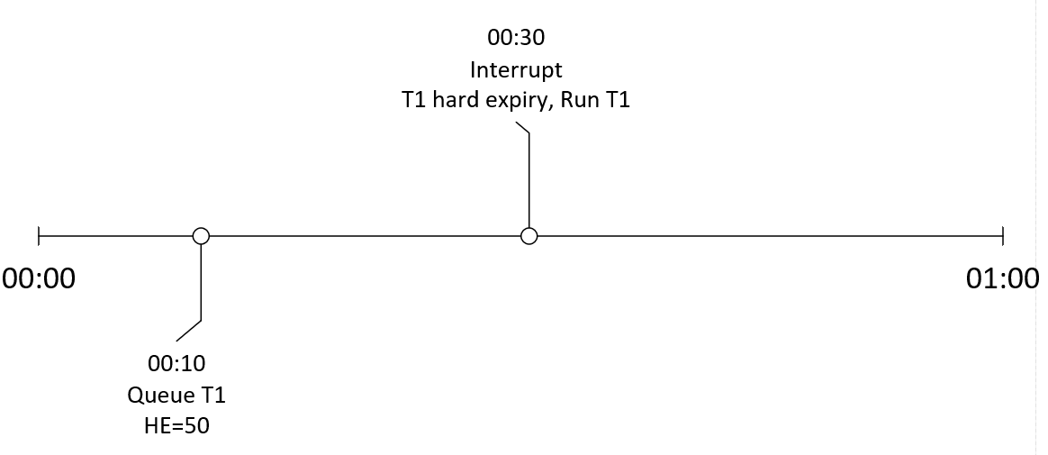
Normal HRtimer without slack
=00:30

Slide 74
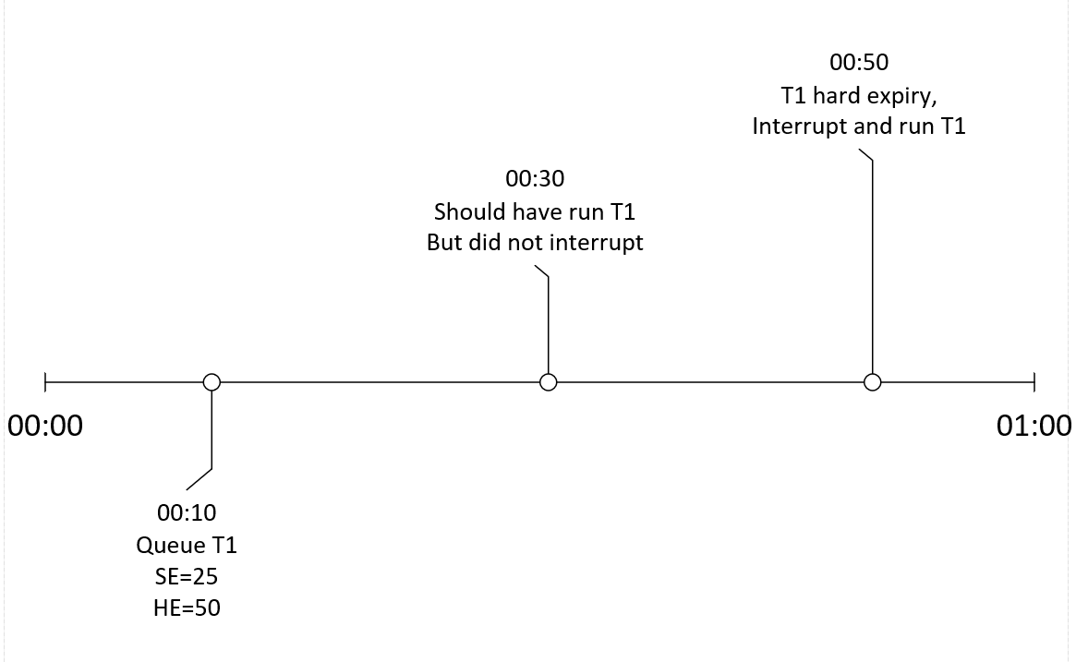
HRtimer with slack expires after soft, AT hard expiry..
00:25

Slide 75
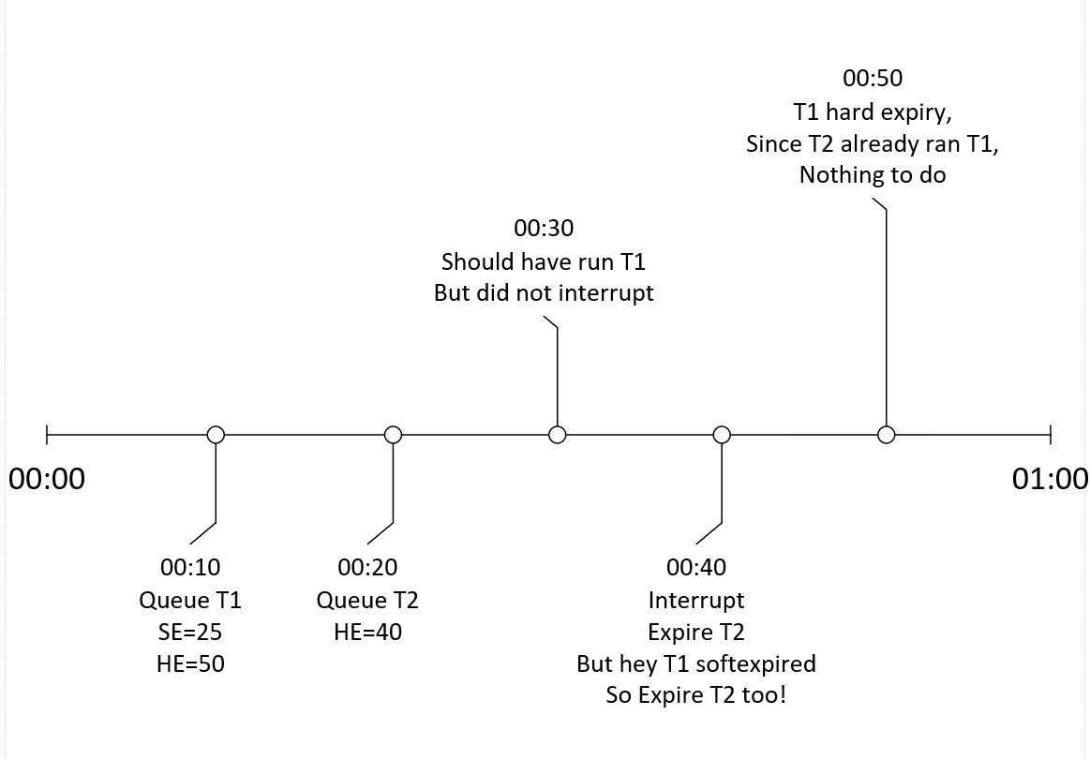
HRtimer with slack expires after soft, before hard expiry.
00:30

Slide 76
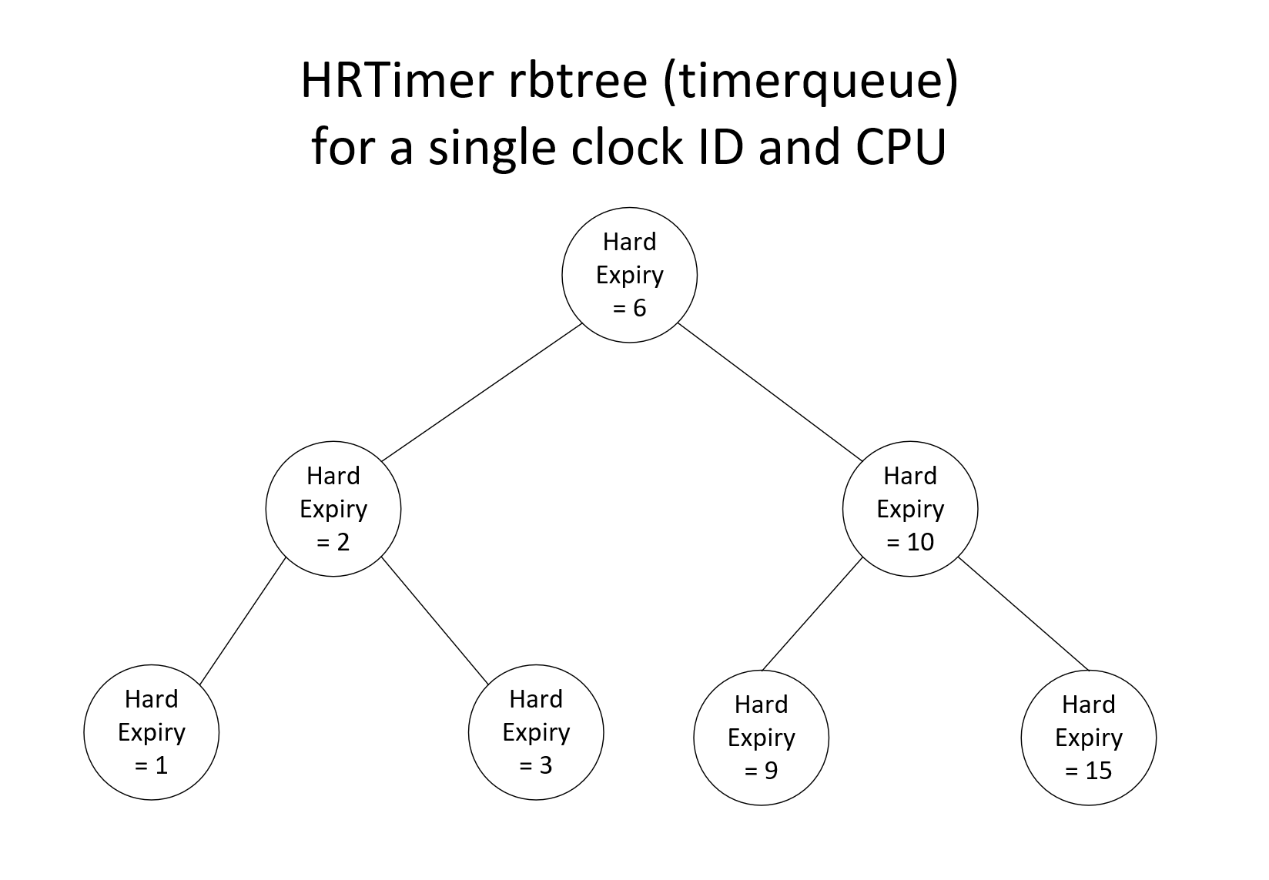
Kernel support - high resolution timers (hrtimer)
Diagram of a single rbtree.

Slide 77
Kernel support - high resolution timers (hrtimer)
Diagram of a single rbtree.
Note: The earliest HARD
expiry time clockevent is programmed!

Slide 78
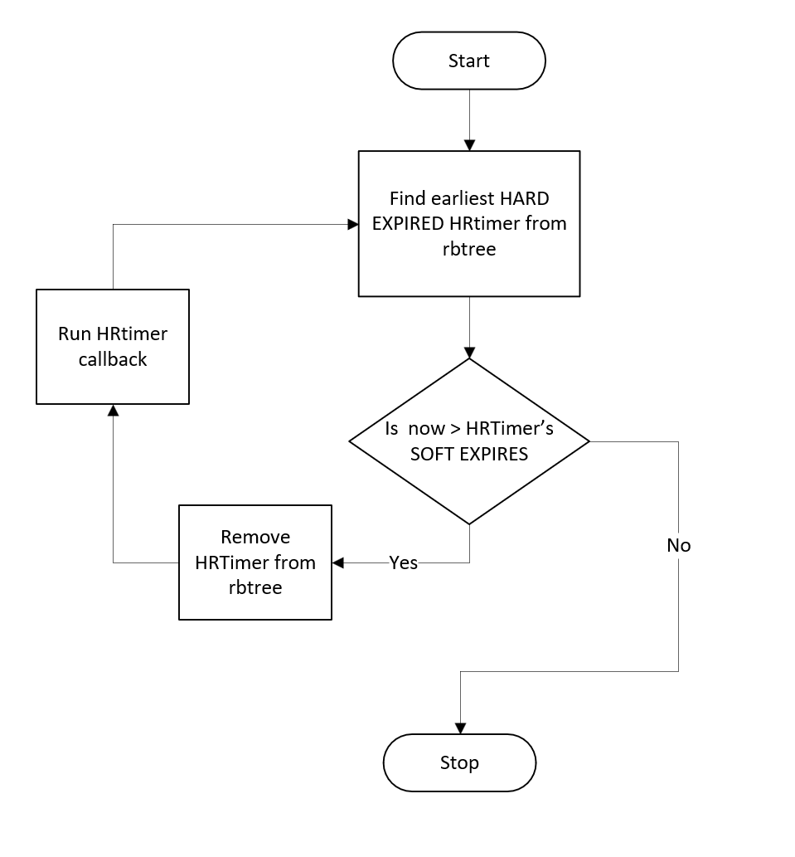
Simplified algorithm for HRTimer expiry
Remember that for normal (non-slack) timers, hard exp == soft exp time.

Slide 79
A soft expired timer may not always execute when a hard expired one runs.
Consider the situation of hard expiries in the timerqueue: [ 5, 10, 20, 30, 40 ]
The corresponding soft expiries for these are : [ 5, 10, 9, 30, 8 ]
Notice that the 3rd and 5th timers are slack (hard expiry != soft expiry)
Say the second timer (a non-slack one) is currently expiring and the time is now T=10.
Now, since the 3rd timer’s soft expiry is 9, that is expired as well.
BUT, timer 5 has also expired and is not considered because we break out of the loop due to timer 4. So, In theory that could have been run but its not!

Slide 80
Kernel support - high resolution timers (hrtimer)
Main takeaways:
Nanosecond resolution instead of jiffies (but depends on hardware, IRQ delays etc)
Higher overhead for insertion, removal than wheel.
Required for Real Time workloads which need high resolution (cyclictest is a test).
Different POSIX clocks have their own rbtree.
Further, all the rbtrees are duplicated for each CPU.
Timer slack can save power by reducing number of interruptions and coalescing.
Soft expired timers may not always run even if they could.
HRtimers are not deferrable unlike timerwheel ones.

Slide 81
Users of Timer wheel vs HRtimers
Use case | Infra
schedule_timeout(jiffies) -- synchronous sleep jiffies until timeout (used a lot in net, fs, gfx, RCU etc.) | timer wheel
Networking, filesystems, misc timeouts | timer wheel
RCU internal machinery | timer wheel
Futex timeout (syscalls accept clockids) | hrtimer
Nanosleep syscall | hrtimer
POSIX clocks, timers, timerfd APIs | hrtimer
Scheduler tick in high res mode | hrtimer (sched_timer)
Timer wheel expiries in high res mode | hrtimer (sched_timer)

Slide 82
Comparison of Timer wheel vs HRtimers
 | Timer wheel | HRtimer
Resolution | Jiffy (1/HZ) | Nanoseconds.
Insert/Deletion Overhead | O(1) | O(log)
Number of IRQs | Low | High
Can be turned off | No | Yes (low res mode, HRtimer API still effective at low accuracy).

Slide 83
Back to the periodic tick..
Now let us get into the periodic tick.
Also known as the tick.
Also known as the scheduling clock interrupt.

Slide 84
Kernel support - Scheduling Clock Interrupt
A timer interrupt that goes at a fixed rate (HZ)
Interval of the interrupts is a “jiffie” (1 / HZ).
One of the primary functions of the tick is for preemptive multitasking.
The HZ rate is a balance between overhead and responsiveness.
“jiffies” is itself a global variable that is incremented by a designated CPU every 1/HZ.

Slide 85
Recall… Kernel Support - Clockevents
A clockevent device abstracts a device which generates interrupt at programmed time in the future.
struct clock_event_device {
void (*event_handler)(struct clock_event_device *);
int (*set_next_event)(unsigned long evt, struct clock_event_device *);
int (*set_next_ktime)(ktime_t expires, struct clock_event_device *);
ktime_t next_event;
u64 max_delta_ns;
u64 min_delta_ns;
u32 mult;
u32 shift;
unsigned int features;
#define CLOCK_EVT_FEAT_PERIODIC 0x000001
#define CLOCK_EVT_FEAT_ONESHOT 0x000002
#define CLOCK_EVT_FEAT_KTIME 0x000004
int irq;
// ...
};
void clockevents_config_and_register(struct clock_event_device *dev,
u32 freq, unsigned long min_delta,
unsigned long max_delta);
Run callback on next event.
Clock event features. ONESHOT is required for NOHZ
Which handler is run depends on the “tick mode” of the system.

Slide 86
The tick internals
Different handler for different tick modes.
Handler | Usage
tick_handle_periodic() | Periodic mode
tick_nohz_handler() | Low res mode
hrtimer_interrupt() | High res mode

Slide 87
The tick internals
Periodic mode
tick_handle_periodic() - Ticks even during Idle
|-----|-----|-----|------|-----|-----|-----|-----|-----|-----|------> time
T1 idle idle idle t2 t3
The tick
Key:
t1, t2, t3: tick’s timer expiry periods.
idle: Idle periods

Slide 88
The tick internals
Low resolution mode (Tickless and low res)
tick_nohz_handler() - No ticks during idle
|-----|------------------|-----|-----|-----|-----|-----|----> Time
t1 idle t2 t3
The tick
Key:
t1, t2, t3: tick’s timer expiry periods.
idle: Idle periods
Also known as NOHZ mode (CONFIG_NOHZ_IDLE).
Requires one-shot mode in clockevent! (fire once in the future at dynamic point)

Slide 89
The tick internals
Note!
In periodic and low res mode: The scheduling clock interrupt handles both Timer wheel and HR timer events!

Slide 90
The tick internals
Comparison between periodic and low res mode
What if need lower resolution
Mode | Periodic | Low Res
Minimum timer resolution | 1 / HZ | 1 / HZ
We already have ONESHOT capable clockevent for low res.
We can program that to fire at any time (nanosecond) in future, not just at 1/HZ.

Slide 91
The tick internals
High resolution mode (Tickless and high res)
Random independent
hrtimers cause same clockevent handler to fire.
hrtimer_interrupt() - No ticks during idle + independent highres irqs.
|-----|------------------|-----|-----|-----|-----|-----|-----|------> time
t1 idle t2 t3
The tick
(In highres mode, The tick is itself an hrtimer!)
Key:
t1, t2, t3: tick’s timer expiry periods.
idle: Idle periods
Compatible with NOHZ mode (CONFIG_NOHZ_IDLE).
Needs a clockevent device capable of firing in one-shot mode (fire once in the future at dynamic point)

Slide 92
The tick internals
Comparison between periodic, low and high res mode
Mode | Periodic | Low Res | High Res
Ticks during idle | Yes | No | No
Minimum timer resolution | 1 / HZ | 1 / HZ | Nanosecond
Hrtimer API | Still works but low in res. | Still works but low in res. | High resolution
Power Savings | Bad | Good | Ok
Practical | No | Could be | Yes
Requires ONE SHOT clockevent | No | Yes | Yes

Slide 93
Kernel support - NOHZ - Turn off the tick
Tick does not need to run when CPU is idle, it wastes power.
CPUidle governor makes a decision about turning off the tick.
CONFIG_NO_HZ_IDLE turns off tick when CPU is idle.
CONFIG_NO_HZ_FULL turns off tick if only 1 task is active or CPU idle.

Slide 94
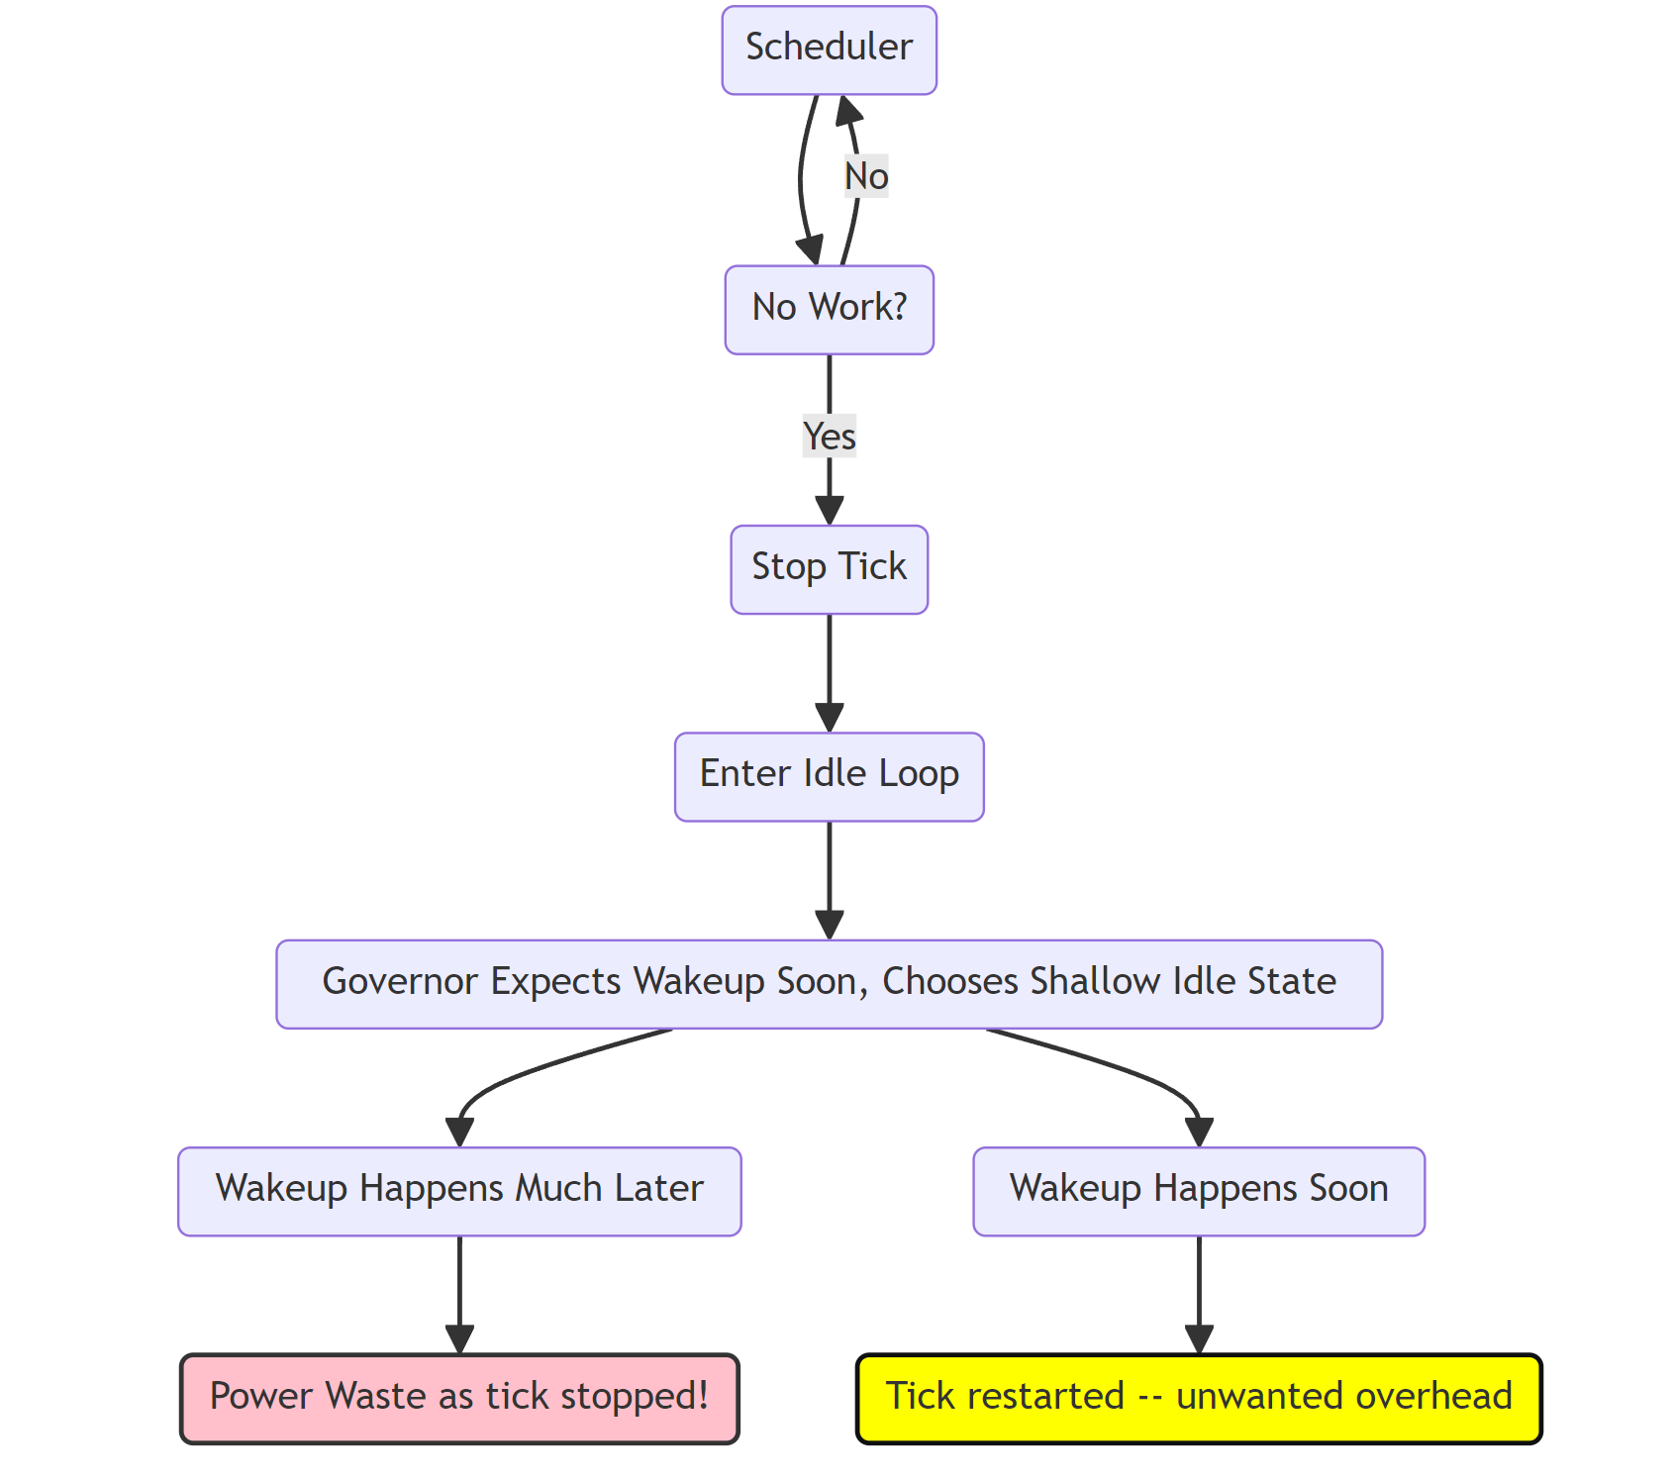
Kernel Support - CPUidle governor and Tick Stop
Old kernels:
Stop tick,
Then choose
Idle state
(Governor
Doesn’t
Stop the tick)

Slide 95
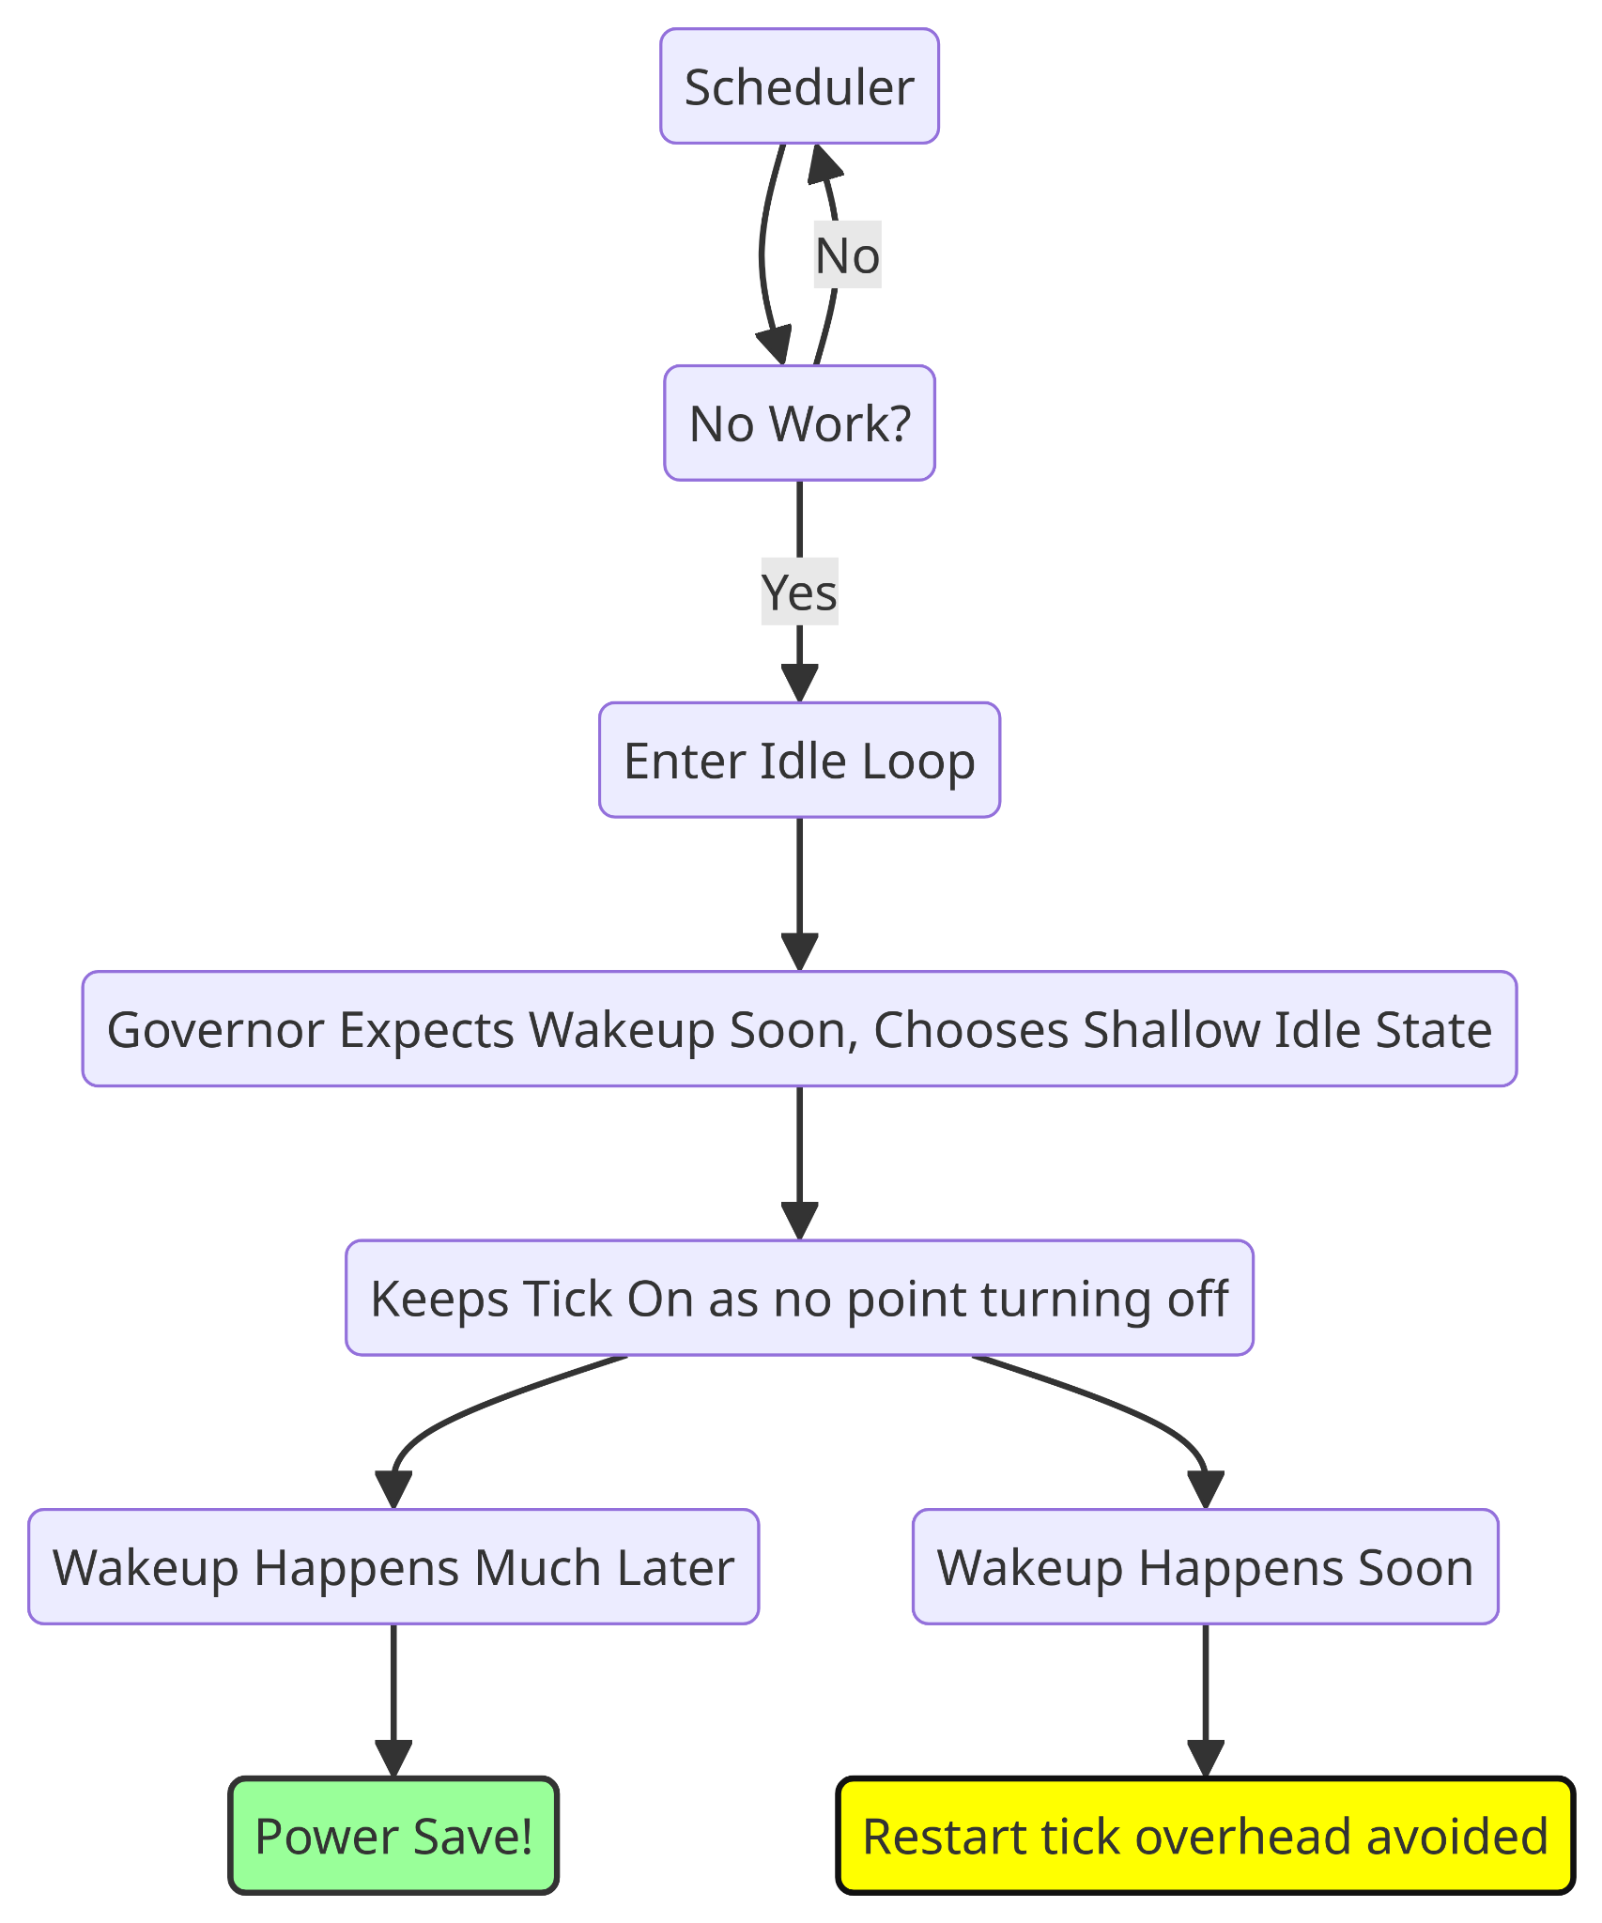
Kernel Support - CPUidle governor and Tick Stop
Newer kernels, 4.16+
Lower overhead and more
Power savings.
Governor chooses idle state and decides to stop the periodic tick.
See commit:
Author: Rafael J. Wysocki <rafael.j.wysocki@intel.com>
Date: Thu Mar 15 23:05:50 2018 +0100
sched: idle: Do not stop the tick upfront in the idle loop
Governor was right and tick restart overhead was avoided
Governor was wrong but “rescue tick” saved it

Slide 96
NOHZ code is boss! Final decision for tick shutdown left to it. (Governor just hints)
Do recall that even though governor decided to stop the tick, if there is an imminent timer event expected,the periodic tick will be left on…
Which relies on the periodic tick

Slide 97
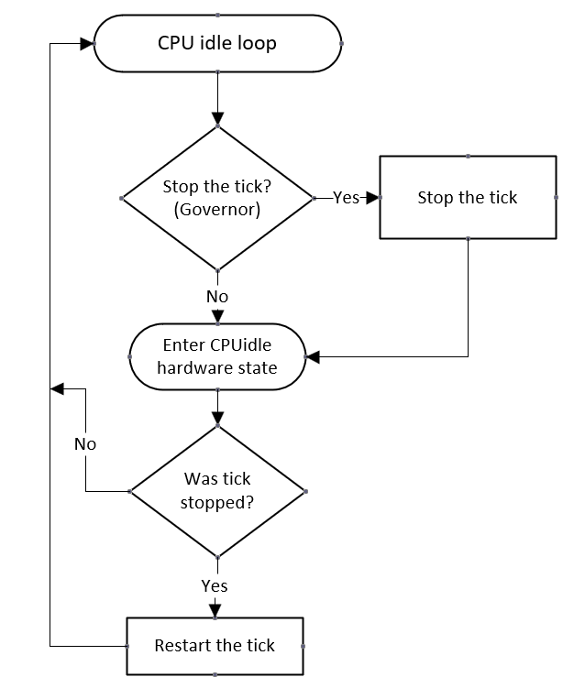
Kernel support - NOHZ - Periodic Tick restart
Tick is unconditionally restarted upon exiting from CPU idle state

Slide 98
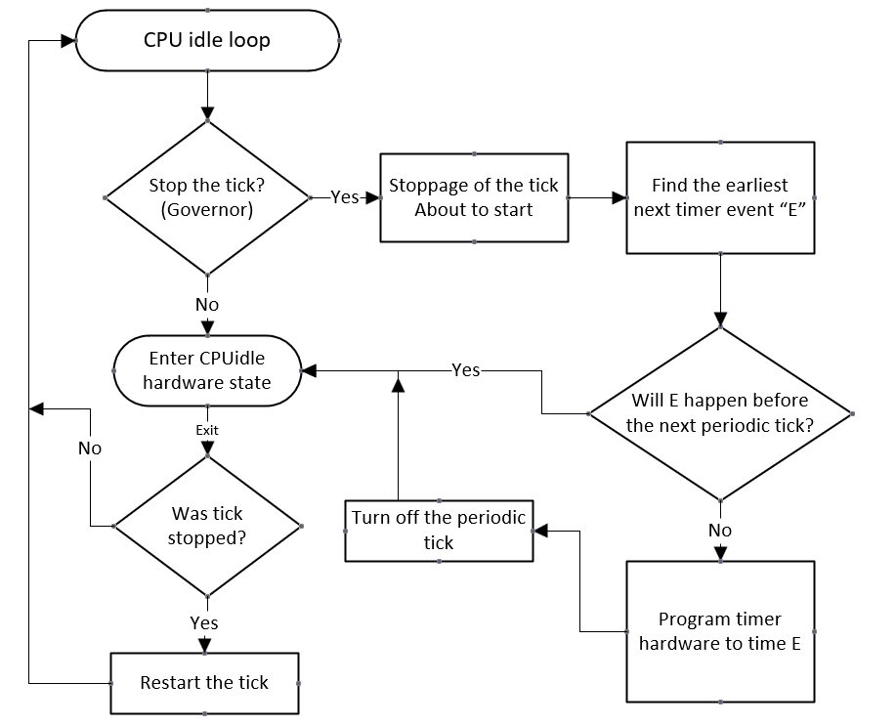
Putting it
Together…
The periodic
tick lifecycle.
Which relies on the periodic tick

Slide 99
VDSO
Some timekeeping syscalls are available as VDSO, like clock_gettime(). Huge perf benefit.
Kernel maps code and data into user space to allow direct calls, not supported on all architectures.
VDSO mapping is an ELF object, similar to a dynamic library, mapped into user space with a dynamic symbol table for function location.
Example, for clock_gettime() VDSO implementation:
VDSO mapping contains a struct vdso_data in the data page for time calculation, including base time, last TSC value, and slope.
Users calculate current time by reading the TSC and applying the formula:
Current time = base time + (current TSC - last cycle) * slope.

Slide 100
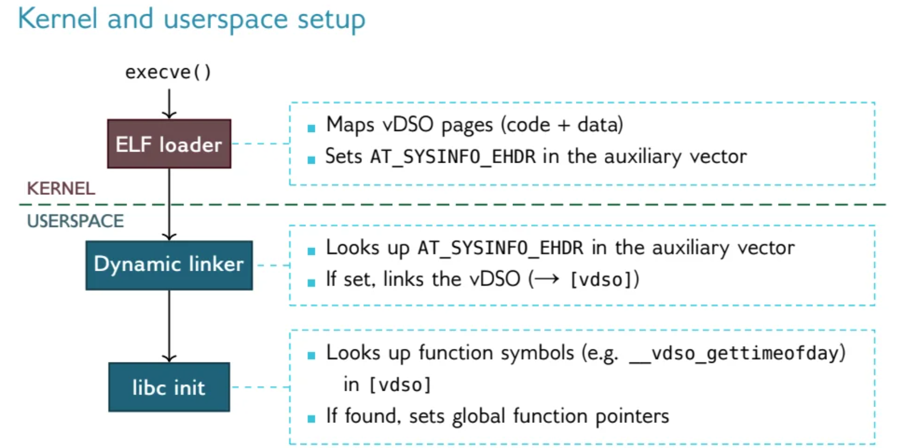
VDSO
makes a note of the VDSO map’s location
and provides helpers to the C library to lookup vdso )

Slide 101
Thank you! It is time!
Until another time… ;-) -Joel

